Slide 1
Cryptocurrency & Blockchain (Finance)
iQ4 Virtual Vault (Cyber Defense)
Notes:
In simple terms, blockchain is a technology that helps keep a record of currency transactions in a detailed manner. These transactions are decentralized without a central record keeping. So, that each player has the record of their transactions. Each transaction is stored in blocks and has detailed information on the currency before it reaches to your wallet. These operations are recorded and distributed in a public ledger for everyone to see and access. It is like if you receive a dollar, that block contains all the notes of the usage of that dollar written on it.
Blockchain technology led to the innovation of Bitcoin – a digital currency that is accepted by many for making payments. This new revolutionary technology can be used for all transactions where the value is involved. Money, property, goods and services are examples where value-based transactions. Unlike our bill which is regulated by the central authority, Bitcoin is unregulated and validated by the users who pay for goods and services.

Slide 2
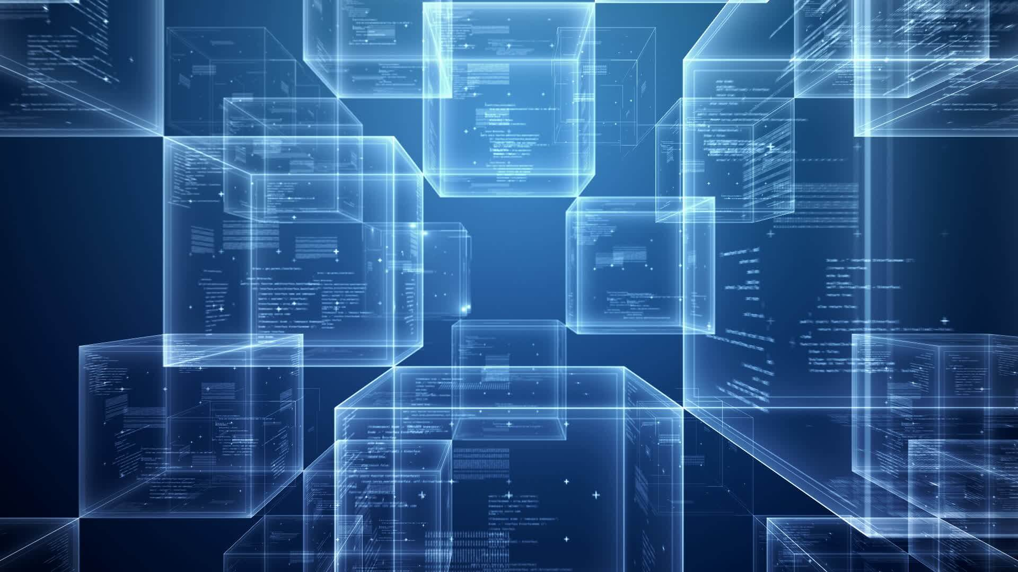
How Blockchain works ?
Stores information in blocks.
Eliminates the need of a centralized system to validate.
It is like an open electronic ledger
Notes:
Blockchain stores information in blocks and it is shared by everyone who is connected to the block. When each user joins the network he/she is connected to the block for executing transactions. Thus, the Bitcoin blockchain will have all the past details of its usage at any of the point that is available for public access. This also eliminates the need for a central system to hold and validate data.
Conventional banking record all the transactions pertaining to the corresponding account and it is held private meaning as it is accessible only to the account holders. Blockchains, in contrast, records all transactions of all users and sends a copy of the transaction to whosoever is connected to the network. The distributed database system is an open electronic ledger and helps reduce complexities that are involved in all business transactions.
Traditional payments systems do not have the flexibility to detail out the history of ownership of particular period.

Slide 3
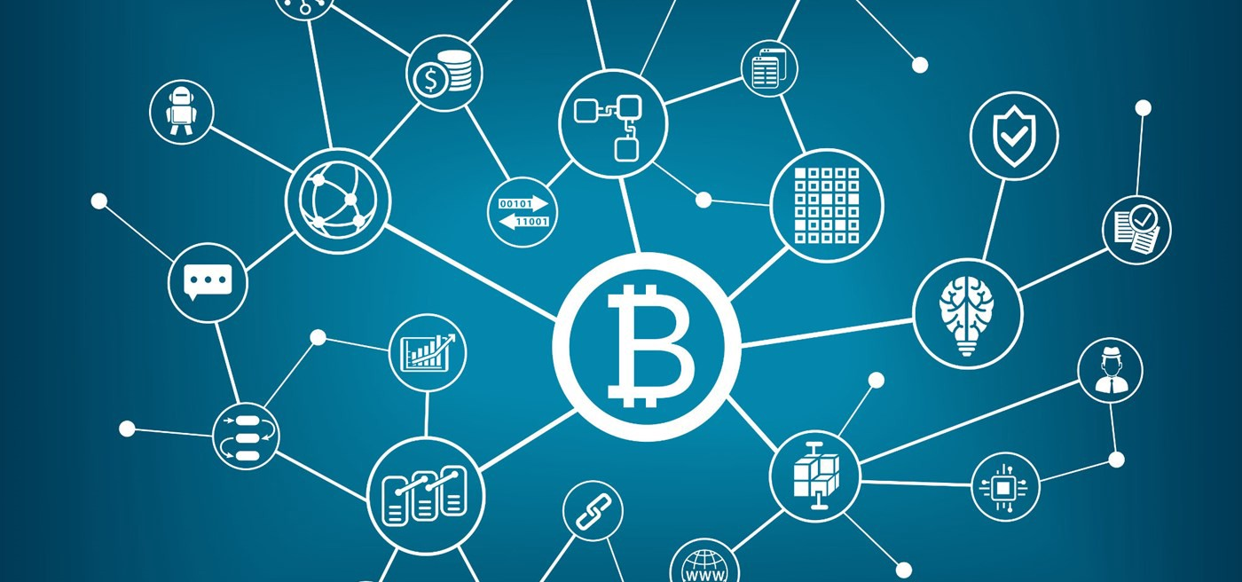
Blockchain in Finance
Decentralized system that enhances payment mechanisms
Bitcoin in Trading arena
Insurance Sector
Notes:
[Decentralized…..mechanisms]: As for the traditional payment system where contracts are fulfilled when certain criteria are met and validated by the central authority. In blockchain transactions, the contracts are stored in public ledger surpassing the middlemen to complete the agreement between the two parties smartly in no time. For instance, if A wants to send money to B, the transaction is made as a block and sends the information to the earlier participants who related to the same money for validating their transactions for approval. Once the deal is approved the money is transferred to B and gets recorded in the ledger sequentially.

Slide 4
Implications of Blockchain Technology
Notes:
In simple terms, blockchain is a technology that helps keep a record of currency transactions in a detailed manner. These transactions are decentralized without central record keeping. So, each player has a record of their transactions. Each transaction is stored in blocks and has detailed information on the currency before it reaches your wallet. These operations are recorded and distributed in a public ledger for everyone to see and access. It is like if you receive a dollar, that block contains all the notes of the usage of that dollar written on it.
Blockchain technology led to the innovation of Bitcoin – a digital currency that is accepted by many for making payments. This new revolutionary technology can be used for all transactions where the value is involved. Money, property, goods, and services are examples where value-based transactions. Unlike our bill which is regulated by the central authority, Bitcoin is unregulated and validated by the users who pay for goods and services.

Slide 5
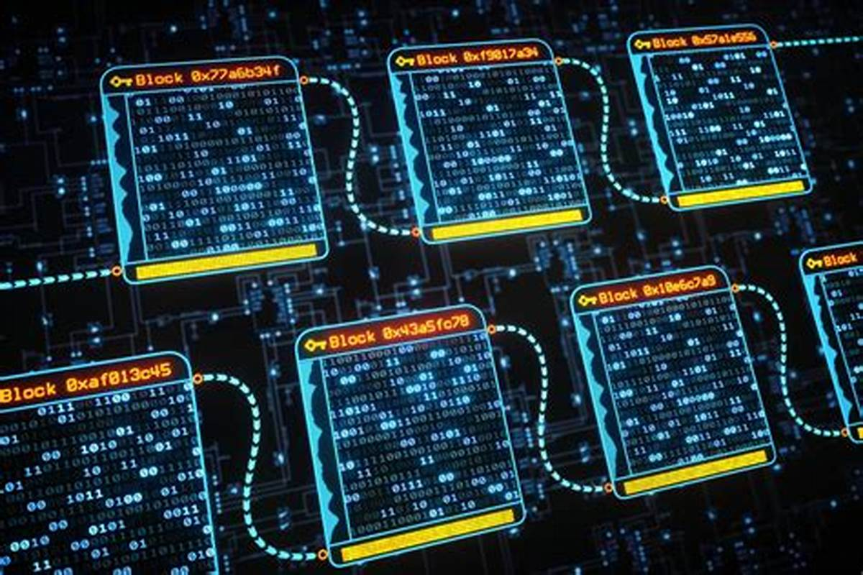
Improving Security
User Authentication
Data Protection
Secure Communication
Speed
Transparency
Decentralization
Smart Contracts
Improved KYC
Global Trade Finance
Notes:
There is no central authority for clearing the transactions. This is the most significant advantage in blockchain as the mechanism is decentralized.
Centralized payment systems are prone to risk as the attacker needs to concentrate on the single entry point. In distributed ledger, one needs to access all networks simultaneously that are connected to the particular transaction that is impossible to succeed. As such these records hold undisputable proof of identity and ownership that prevents fraud and counterfeiting. Blockchain works on a trusted platform where the parties that validate the transactions are called miners. As the data are interconnected transaction gets verified automatically.
User authentication – blockchain eliminates the necessity to protect user and bank accounts and devices with passwords. Instead, the technology combines blockchain security with biometrics, encrypting users’ unique identifiers e.g. iris scans, fingerprints, voice, etc. into a block in blockchain. The technology uses the encrypted block with user identifiers as an access key to apps and gadgets or as a key to sign the data the user sends to others.
Data protection – due to the decentralized nature of blockchain, cyber criminals have to work with an entire blockchain system rather than a central node to hack it. Since the data is spread across multiple nodes, there is no particular server or another place to attack. For this reason, some banking institutions use blockchain for data storage and securing transactions.
Secure communication – blockchain can be used for securing internal communication, preventing any data leakages or cyber espionage. The technology spreads the metadata utilized for communications around the distributed ledger, making it impossible for hackers to collect it at one centralized point.

Slide 6
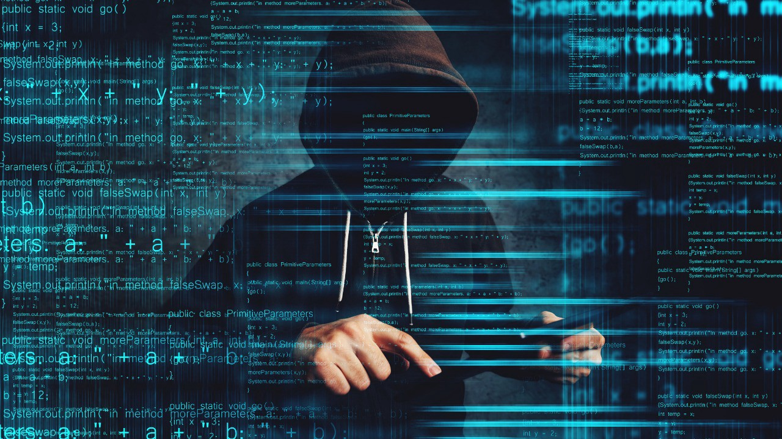
Potential Areas
Cryptocurrency Trading Platforms
Ransomware incidents
Notes:
Cybercriminals can hack into cryptocurrency trading platforms and steal funds. Cryptocurrency is already the most preferred form of exchange in cases of ransomware attacks.
Cybercriminals can hide their true identities when asking for ransom in digital currencies. When making an exchange, they can easily convert cryptocurrencies into traditional forms without ever being discovered. They can attack any business and ask for ransom in digital currencies since this form of cybercrime is practically untraceable with no evidence linked to the criminal.

Slide 7
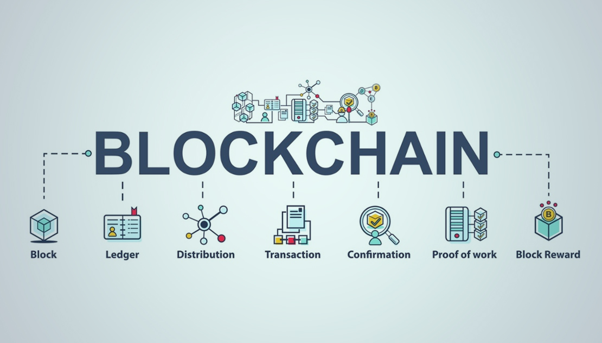
Potential Disruptions
Dirsrupts commercial banking system
Supply chain management
Real Estate
Notes:
Blockchain disrupts commercial baking system by providing a peer-to-peer payment system with high security and low fees. So there is no central authority. This eliminates the need for a third party to make a transaction using a cryptocurrency, like Bitcoin or one of the many others. Your transaction to your friend is recorded in a ledger that is viewed and reviewable by any of the cryptocurrency users – giving you true autonomy over your transaction.
Blockchain technology can trace all the steps of a supply chain, so that, let’s say, you placed an order for food, had the food delivered, and found the food disgusting. The owner of the company from whom you ordered it could go back through his blockchain ledger and find out where in the supply chain the order went wrong. In other words, in supply chain management, blockchain provides permanent transparency and validation of transactions shared by multiple supply chain partners. All transactions are permanent and verifiable, making it easy for an owner or a customer to view each record.
Deploying blockchain technology in real estate increases the speed of the conveyance process and eliminates the need for money exchanges.

Slide 8
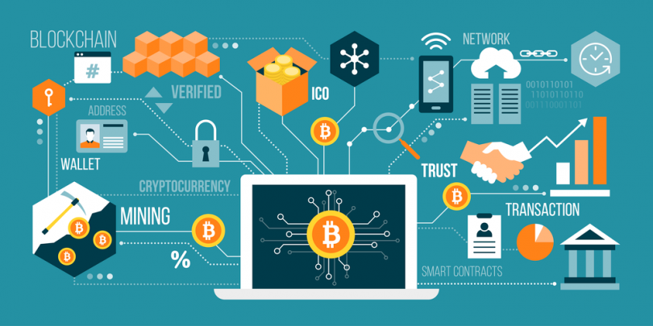
Next Steps to be Taken:
ADDITIONAL READING
External Websites:
1- Beyond Bitcoin: Emerging Applications for Blockchain Technology
2-CFTC and Virtual Currencies: New Court Rulings and Implications for Congress
International Approaches to Digital Currencies

Slide 9
Sources
https://marutitech.com/blockchain-technology-implications-financial-platform/
https://scand.com/company/blog/blockchain-in-banking-and-finance/#:~:text=%20Here%20is%20how%20blockchain%20can%20improve%20security,preventing%20any%20data%20leakages%20or%20cyber...%20More%20
https://www.simplilearn.com/tutorials/blockchain-tutorial/blockchain-industries

